Slide 1
Decentralized Smart Energy Grid Solutions
A demand side approach to power regulation.

Slide 2
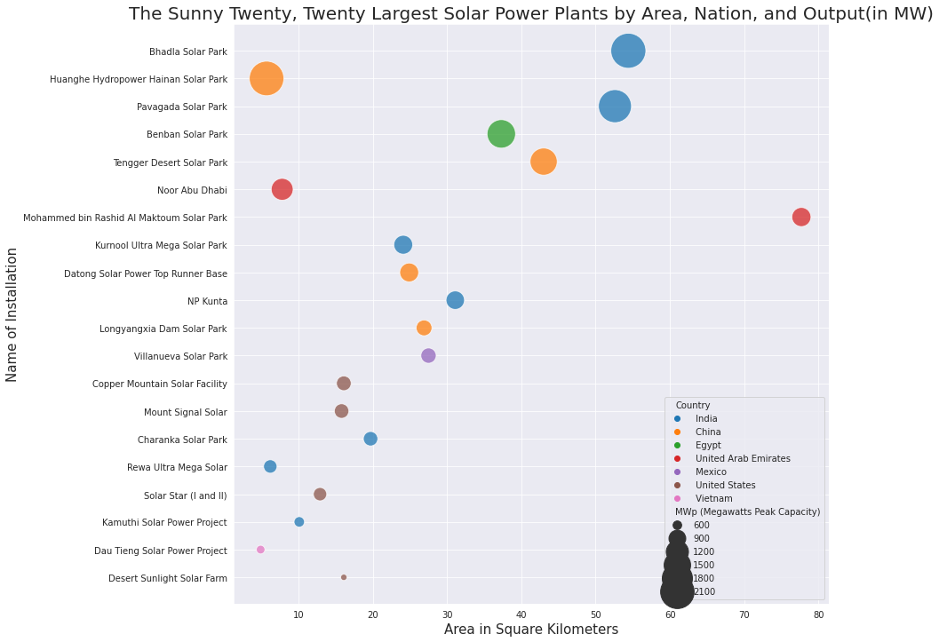
Increasing Demand for Renewable Energy

Slide 3




The Four Star Grid

Slide 4
What is in the data
What is in it
Three key variables
P- Power produced/consumed
G- Coefficient proportional to price elasticity
And T – Each participants reaction time to an electrical price change.
What is it about
Variables explore the stability during operation.
Where did it come from
Created by V. Arzamasov, Bohm K, Jochem P and provided to the UCI Machine Learning Repositry.

Slide 5
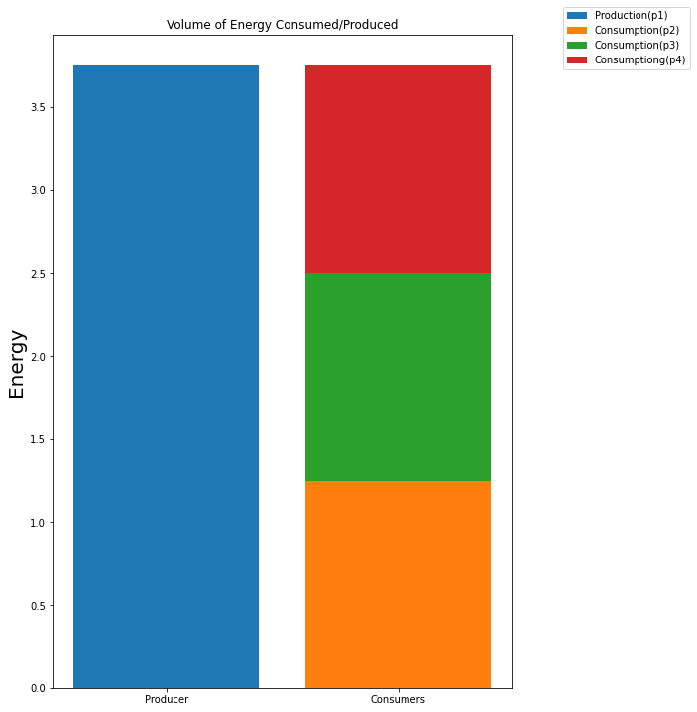
Distribution of Energy

Slide 6
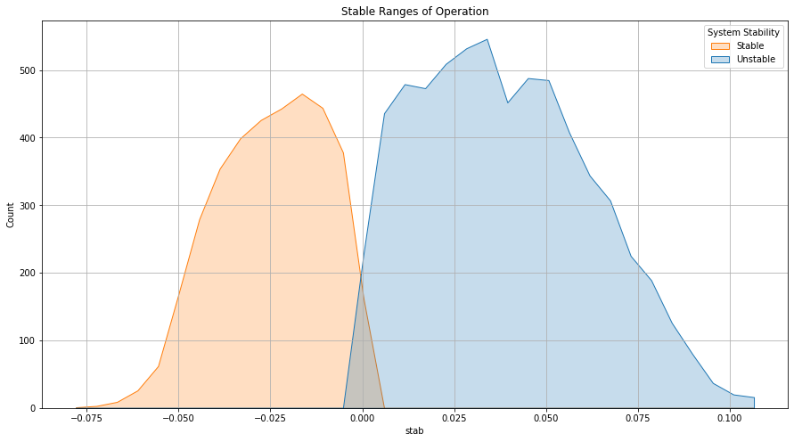
Optimal Ranges of Stability

Slide 7
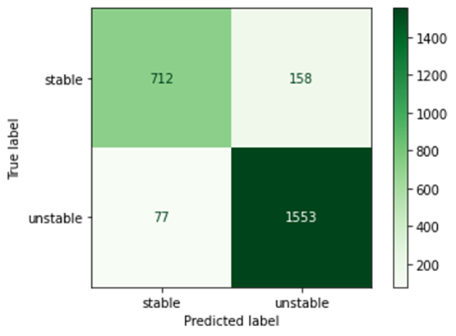
Results from testing
 | Precision | Recall | F1-score | Support
Stable | 0.90 | 0.82 | 0.86 | 870
Unstable | 0.91 | 0.95 | 0.93 | 1630
Accuracy |  |  | 0.91 | 2500
Macro Avg | 0.91 | 0.89 | 0.89 | 2500
Weight Avg | 0.91 | 0.91 | 0.90 | 2500
91% accuracy
Only 77 False positives

Slide 8
Recommendations
Real world tests
Testing with Prosumers

Slide 9

The Planet and I Thank You!

